Slide 1


Slide 2

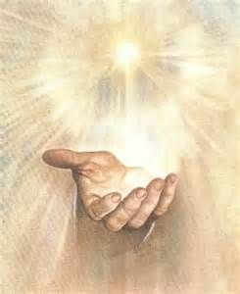
Who Holds Your Future?
Luke 1:26-38
Matthew 1:18-25
Jeremiah 29:11

Slide 3
Mary’s Invitation
To Follow God Into A New Future
(vv. 31-33)

Slide 4
Mary’s Response
I Am In
(v. 38)

Slide 5
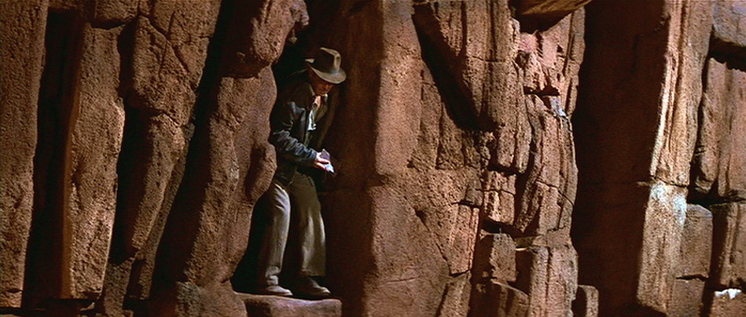

Slide 6
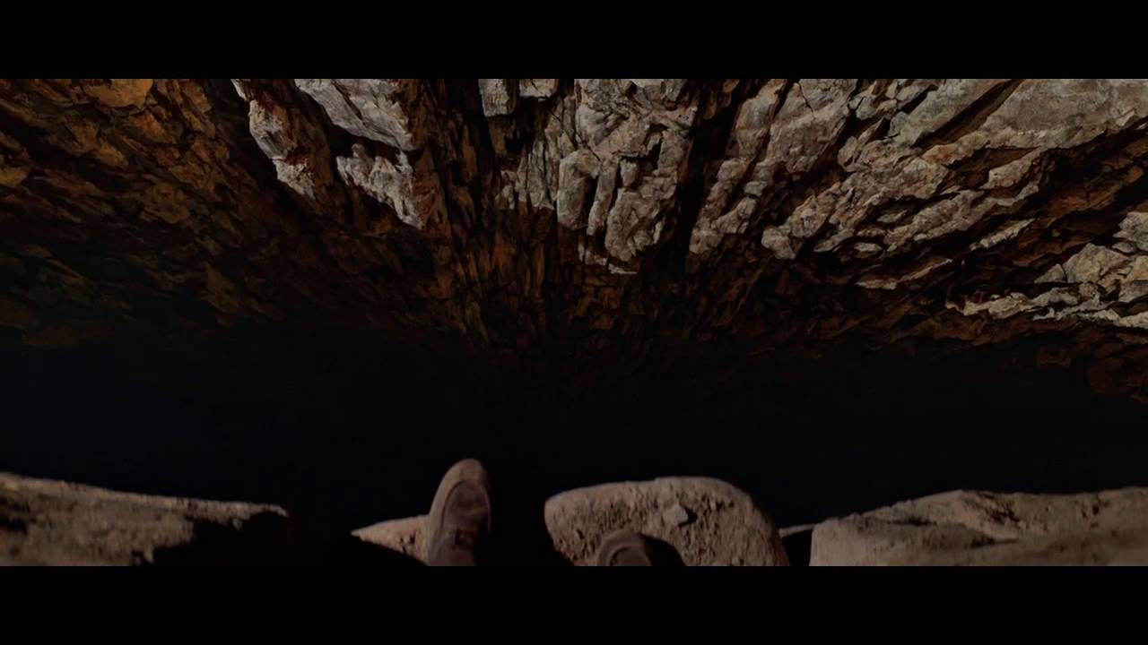

Slide 7


Slide 8
Mary’s Response
I Am In
(v. 38)

Slide 9
Matthew 1:18-25

Slide 10
Joseph’s Invitation
To Follow God Into A New Future
(vv. 31-33)

Slide 11
Joseph’s Response
I Out
(v. 19)

Slide 12
Joseph’s Second Response
He Gave His Future To The Lord
(v. 24)

Slide 13
Who Holds Your Tomorrows?

Slide 14
Who Holds Your Future?

