Slide 1


Slide 2
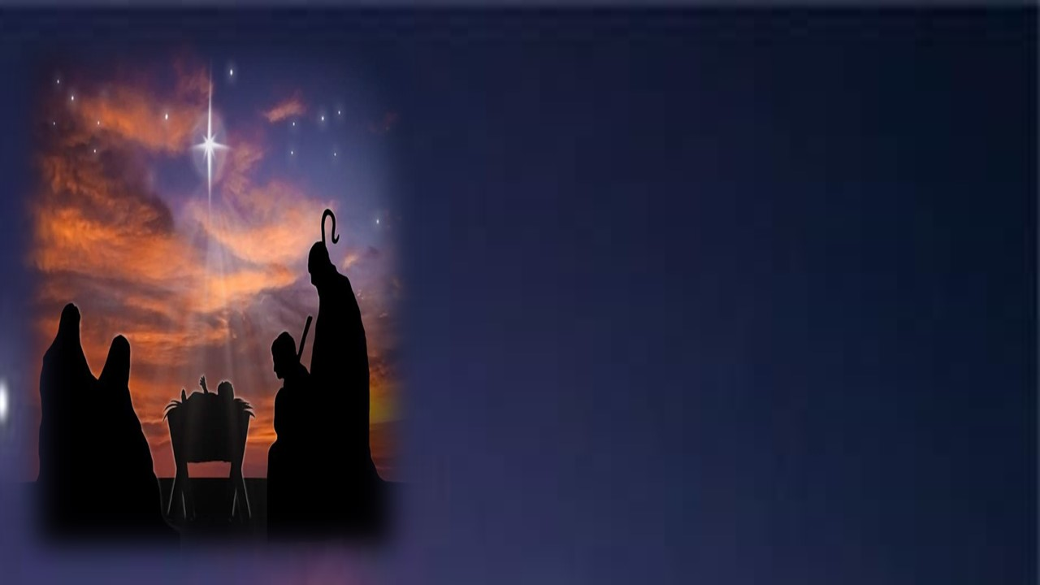
GOD MEETS US IN THE ORDINARY
LUKE 2:8-20

Slide 3
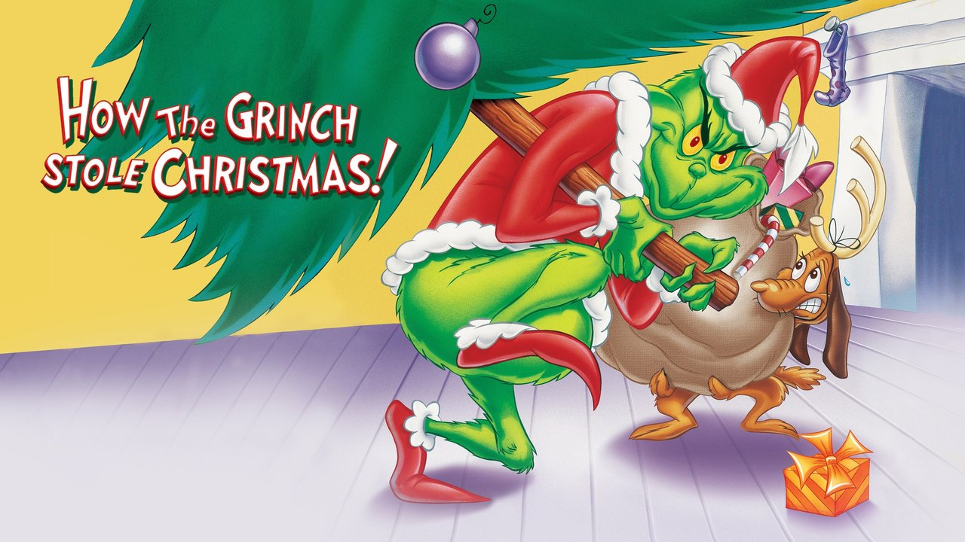

Slide 4
GOD MEETS US IN THE ORDINARY
LUKE 2:8-20

Slide 5
WHO IS OUR STORY ABOUT?
THE SHEPHERDS

Slide 6
WHERE WERE THE SHEPHERDS?
IN THE FIELD

Slide 7
WHERE WERE THE SHEPHERDS?
IN THE MIDST OF AN ORDINARY DAY

Slide 8
WHAT HAPPENED TO THE SHEPHERDS?

Slide 9
GOD MET THEM IN THE MIDST OF THE ORDINARY

Slide 10
WHY DID GOD MEET THESE SHEPHERDS?

Slide 11
THEY WERE WATCHING FOR GOD’S HAND AND LISTENING FOR HIS VOICE

Slide 12
IN ORDER TO INVITE THEM TO USED IN THE ORDINARY

Slide 13
WILL YOU LET GOD USE YOU IN THE ORDINARY?

