Slide 2
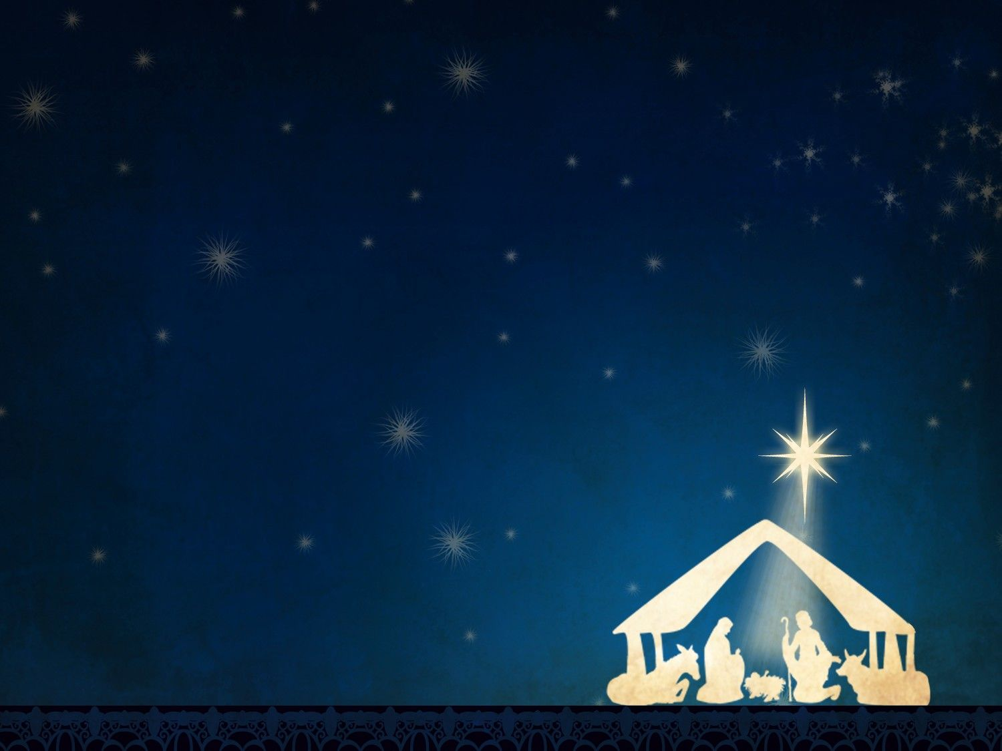
WHO IS THIS CHILD?
LUKE 2:1-7
JOHN 1:1-15

Slide 3
WHO IS THIS CHILD?
ETERNAL

Slide 4
WHO IS THIS CHILD?
ETERNAL
GOD

Slide 5
WHO IS THIS CHILD?
ETERNAL
GOD
CREATOR

Slide 6
WHO IS THIS CHILD?
ETERNAL
GOD
CREATOR
LIFE

Slide 7
WHO IS THIS CHILD?
RULER

Slide 8
WHO IS THIS CHILD?
RULER
HUMAN

Slide 9
WHO IS THIS CHILD?
RULER
HUMAN
LIGHT

Slide 10
WHO IS THIS CHILD?
RULER
HUMAN
LIGHT
SAVIOR

Slide 11
WHO IS THIS CHILD?
~ETERNAL ~RULER
~GOD ~HUMAN
~CREATOR ~LIGHT
~LIFE ~SAVIOR

