Slide 1


Slide 2
Amazed
Luke 2:8-14

Slide 3
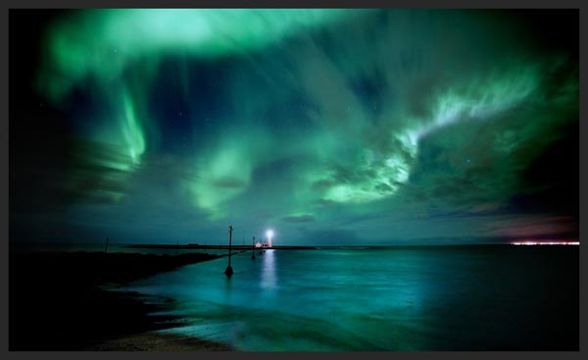

Slide 4
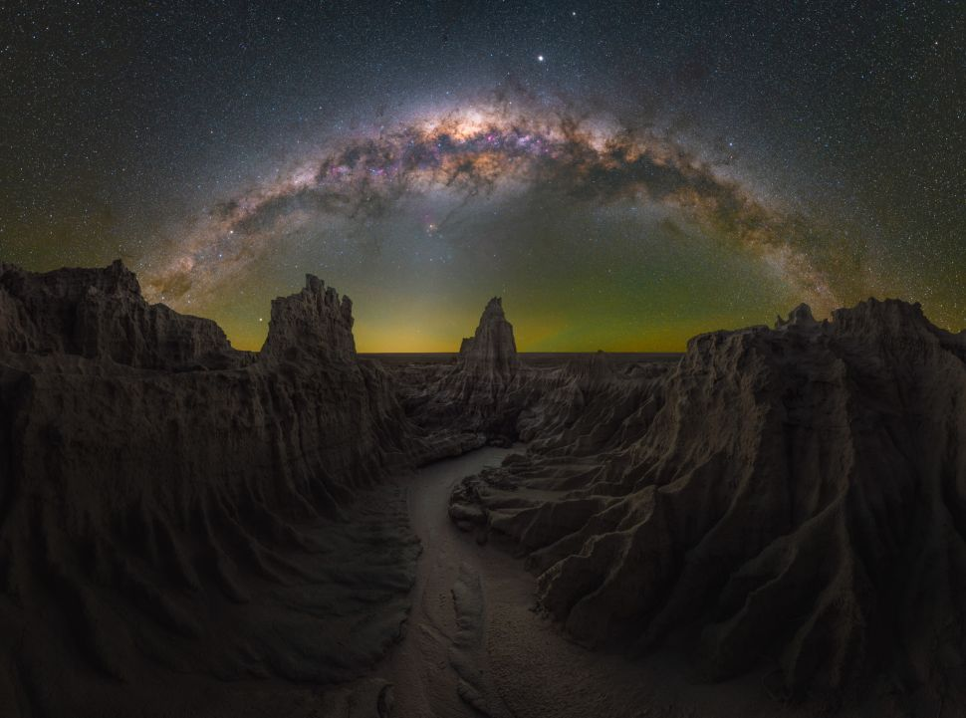

Slide 5
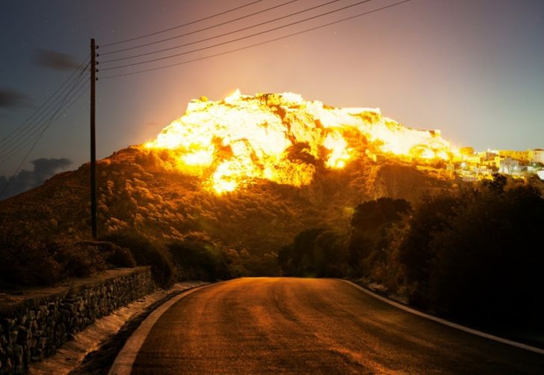

Slide 6
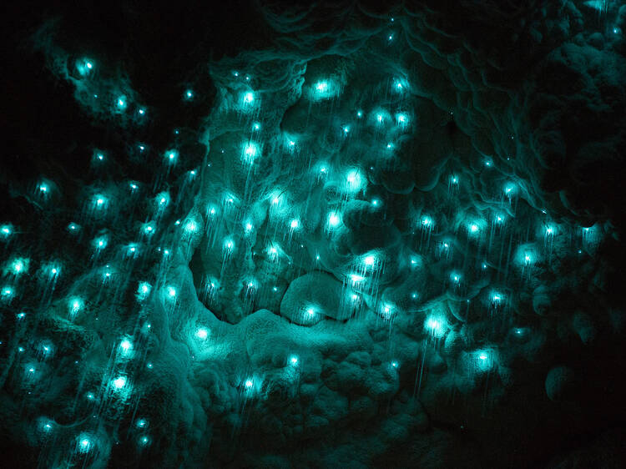

Slide 7
Amazed
Luke 2:8-14

Slide 8
The Angel’s Appearance
(vv. 8-9)

Slide 9
The Angel’s Announcement
(vv. 10-12)

Slide 10
The Angels’ Amazement
(v. 14)

Slide 11
The Angels Are Amazed By God’s Love

Slide 12
The Angels Are Amazed By God’s Faithfulness

Slide 13
The Angels Are Amazed By God’s Favor

Slide 14
Only As We Stand Amazed Will We Sing God’s Praises

