Slide 2
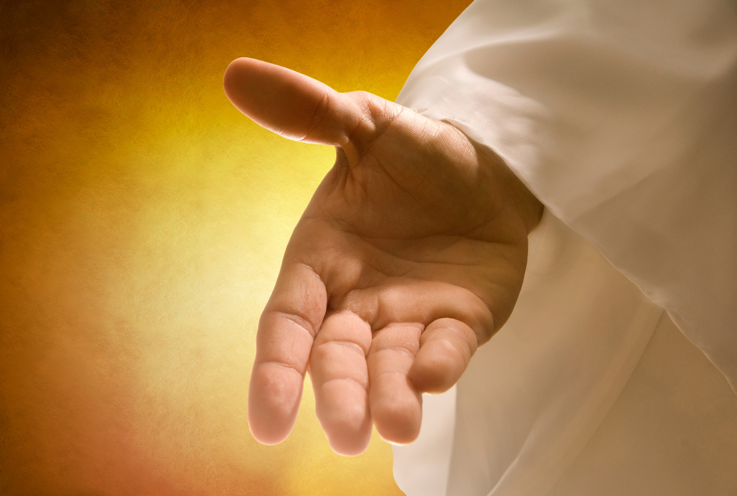
SHOWING GOD’S HEART
GENESIS 3:1-24

Slide 3
Are We Showing The Heart Of God And Loving People Where They Are?

Slide 4
The Fall
Adam & Eve Ate The Fruit

Slide 5
The Fall
Adam & Eve Ate The Fruit
They Hid

Slide 6
The Fall
Adam & Eve Ate The Fruit
They Hid
They Realized Their Guilt
Before God

Slide 7
God Came To Them

Slide 8
God Came To Them
Those Who Were Broken

Slide 9
God Came To Them
Those Who Were Broken
They Came Out Of Hiding

Slide 10
God Came To Them
Those Who Were Broken
They Came Out Of Hiding
They Are Drawn To God

Slide 11
A God Who Is Compassionate, Gracious, Slow To Anger And Abounding In Love And Faithfulness
Genesis 34:6

Slide 12
Only After They Saw God’s Heart Were They Open To Dealing With Their Sin

Slide 13
Jesus Comes To Us Where We Are And Shows Us His Heart

