Slide 1
Thanks, But No Thanks Luke 4:14-30 (Matt. 7:28-29, Matt. 18:20, John 4:46)

Slide 2
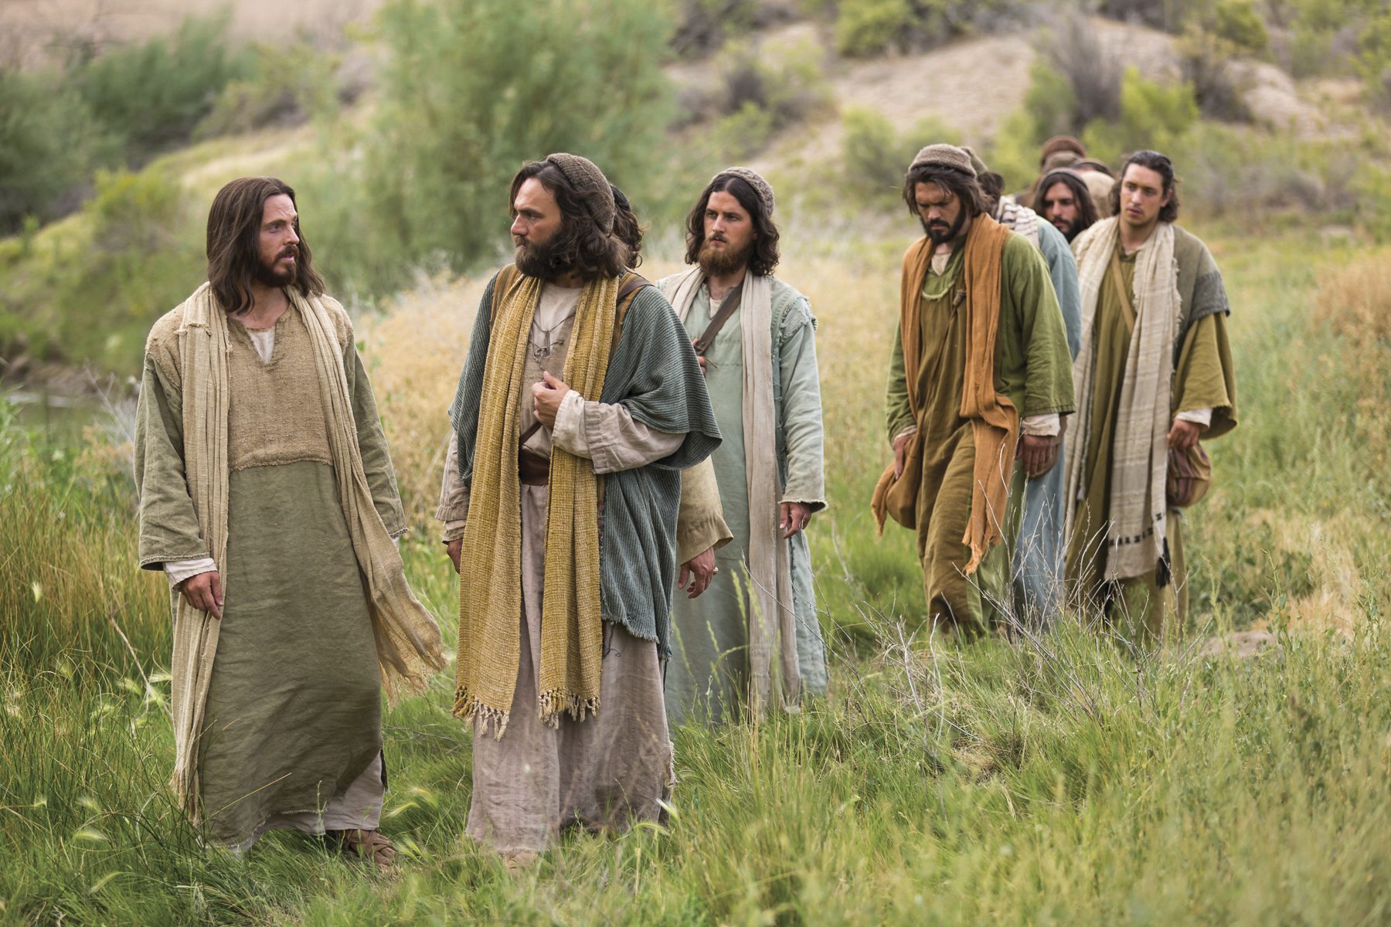
Jesus Goes To Galilee

Slide 3
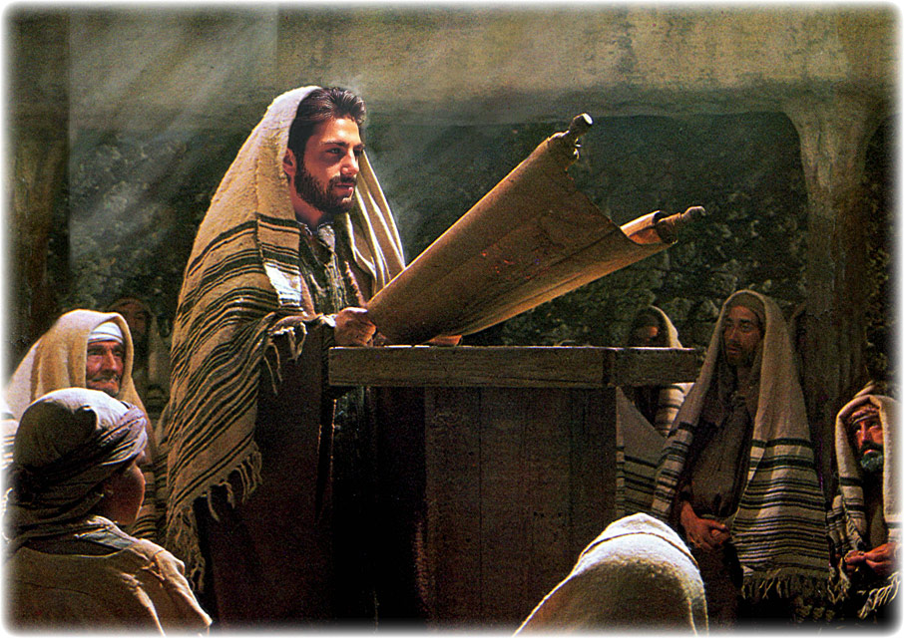
Jesus Gathers With God’s People

Slide 4
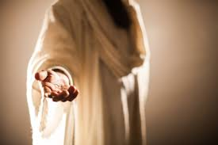
Jesus Gives His Gift
~~~~~~~~~

Slide 5
Jesus Gives His Gift
~~~~~~~~~
Answered Prayer

Slide 6
Thanks, But No Thanks

Slide 7
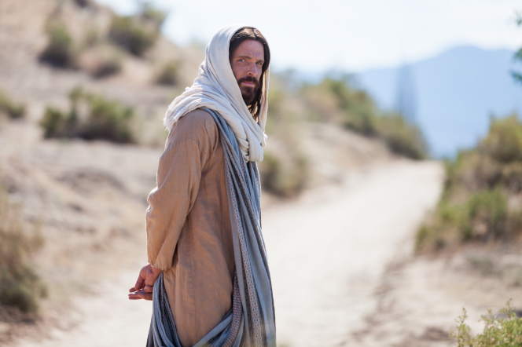
Jesus Go Away

Slide 8
Because They Send Jesus Away, They Miss Out On Experiencing God

Slide 9
Do You Take His Hand Or Watch Him Walk Away

