Slide 1

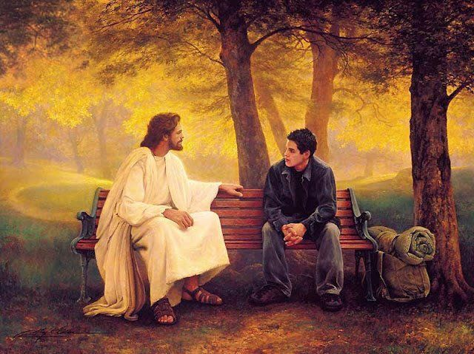

Distracted
Luke 10:31-48

Slide 2

Martha’s Invitation

Slide 3
The Preparation

Slide 4
The Frustration

Slide 5
The Confrontation

Slide 6
I Have Too Much To Do To Spend Time With You Right Now

Slide 7
If The Devil Can’t Make You Sin, He Will Make You Busy

Slide 8
The Distraction
~~~~~~~~~~~~~~~~~~~~~~~~~~~~~

Slide 9
The Distraction
~~~~~~~~~~~~~~~~~~~~~~~~~~~~~
Busyness

Slide 10
Jesus’ Invitation
~~~~~~~~~~~~~~~~~~~~~~~~~~~~~

Slide 11
Jesus’ Invitation
~~~~~~~~~~~~~~~~~~~~~~~~~~~~~
Spend Time With Me

Slide 12
Only As We Give Ourselves To Jesus Can He Give Himself To Us

Slide 13
Are We Making Time For Jesus Every Day?

