Slide 1

Mark 15:1-26

Slide 2


Slide 3
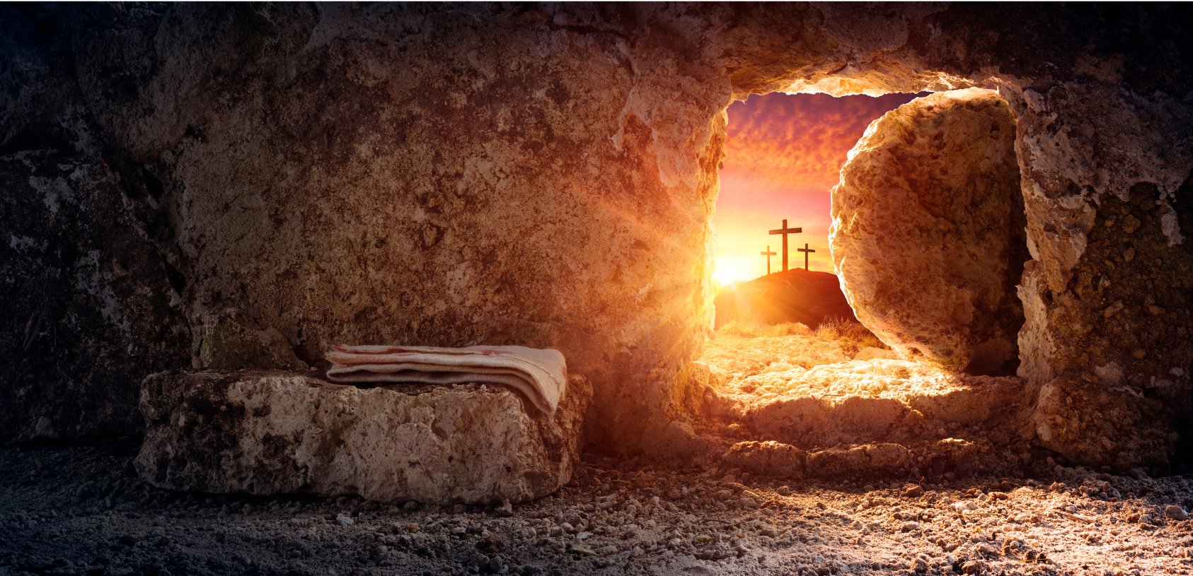
Our Stone
Has Been
Rolled Away
Matthew 28:1-10
(Isaiah 52:14)

Slide 4
He is risen

Slide 5
What did Jesus accomplish on the cross?
He paid for your sins and mine

Slide 6
We can walk out of our grave

Slide 7
How do we walk out of our tomb?
We embrace Jesus

Slide 8
Are you standing in the darkness of your tomb or in the light of Jesus love?

Slide 9
You have been set free!

Slide 10
Is your tomb empty?

Slide 11
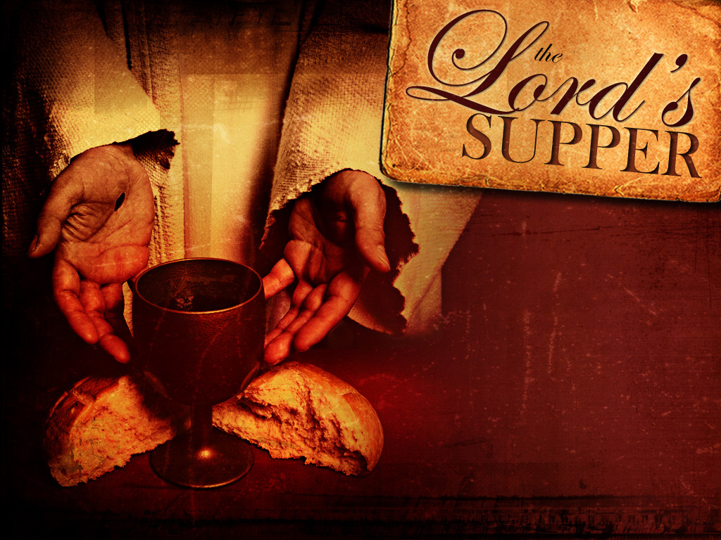
Celebrating our risen Savior

