Slide 2
PREPARING FOR VICTORY
Joshua 3-4

Slide 3
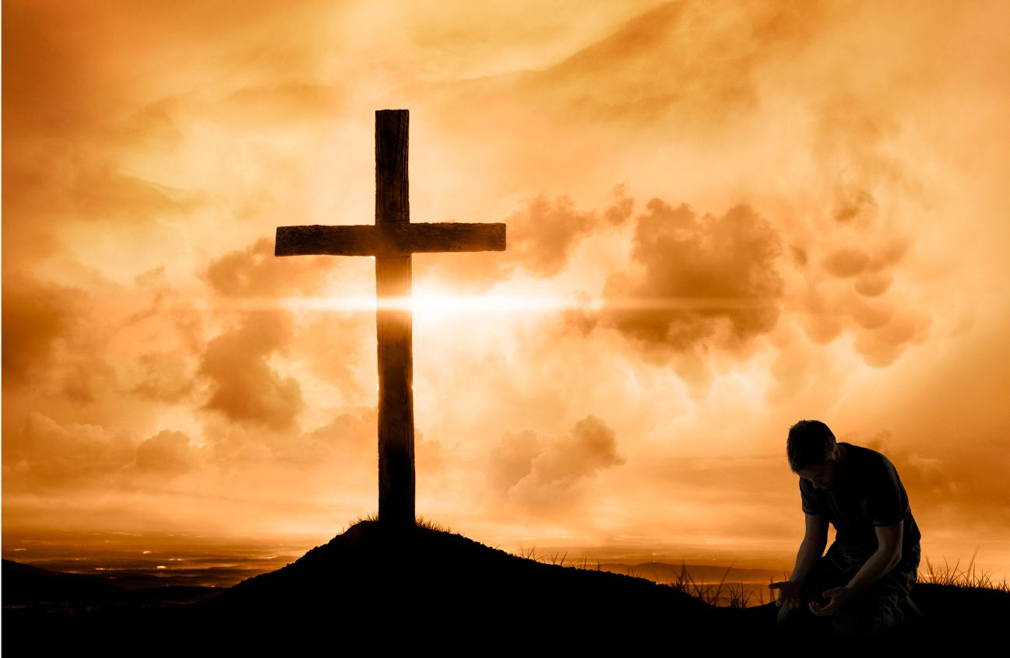
The first step in preparing for victory
Consecrating Ourselves

Slide 4
The second step in preparing for victory Putting doubt aside

Slide 5
The third step in preparing for victory Moving forward with the Lord

Slide 6
They prepared for victory, as a result, they experienced victory

Slide 7
The fourth step in preparing for victory Remember the victory

Slide 8
Preparing for Victory
Consecrating ourselves
Putting doubt aside
Moving forward with the Lord
Remembering the victory

